Slide 1

Database Connectivity

Slide 2
Temperature Converter App
from tkinter import *
def fahrenheit_to_celsius():
"""Convert the value for Fahrenheit to Celsius and insert the
result into lbl_result.
"""
fahrenheit = txt_temp.get()
celsius = (5/9) * (float(fahrenheit) - 32)
lbl_result["text"] = f"{round(celsius, 2)} \N{DEGREE CELSIUS}"
window = Tk()
window.title("Temperature Converter")
frm_entry = Frame(master=window)
txt_temp = Entry(master=frm_entry, width=10)
lbl_temp = Label(master=frm_entry, text="\N{DEGREE FAHRENHEIT}")
txt_temp.grid(row=0, column=0, sticky="e")
lbl_temp.grid(row=0, column=1, sticky="w")

Slide 3
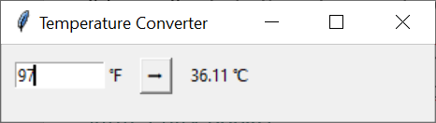
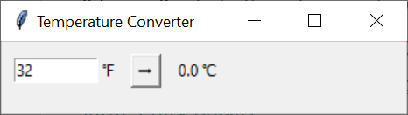
Temperature Converter App
btn_convert = Button(
master=window,
text="\N{RIGHTWARDS BLACK ARROW}",
command=fahrenheit_to_celsius
)
lbl_result = Label(master=window, text="\N{DEGREE CELSIUS}")
frm_entry.grid(row=0, column=0, padx=10)
btn_convert.grid(row=0, column=1, pady=10)
lbl_result.grid(row=0, column=2, padx=10)
#frm_entry.pack()
window.mainloop()

Slide 4
Database Connectivity with MySQL

Slide 5
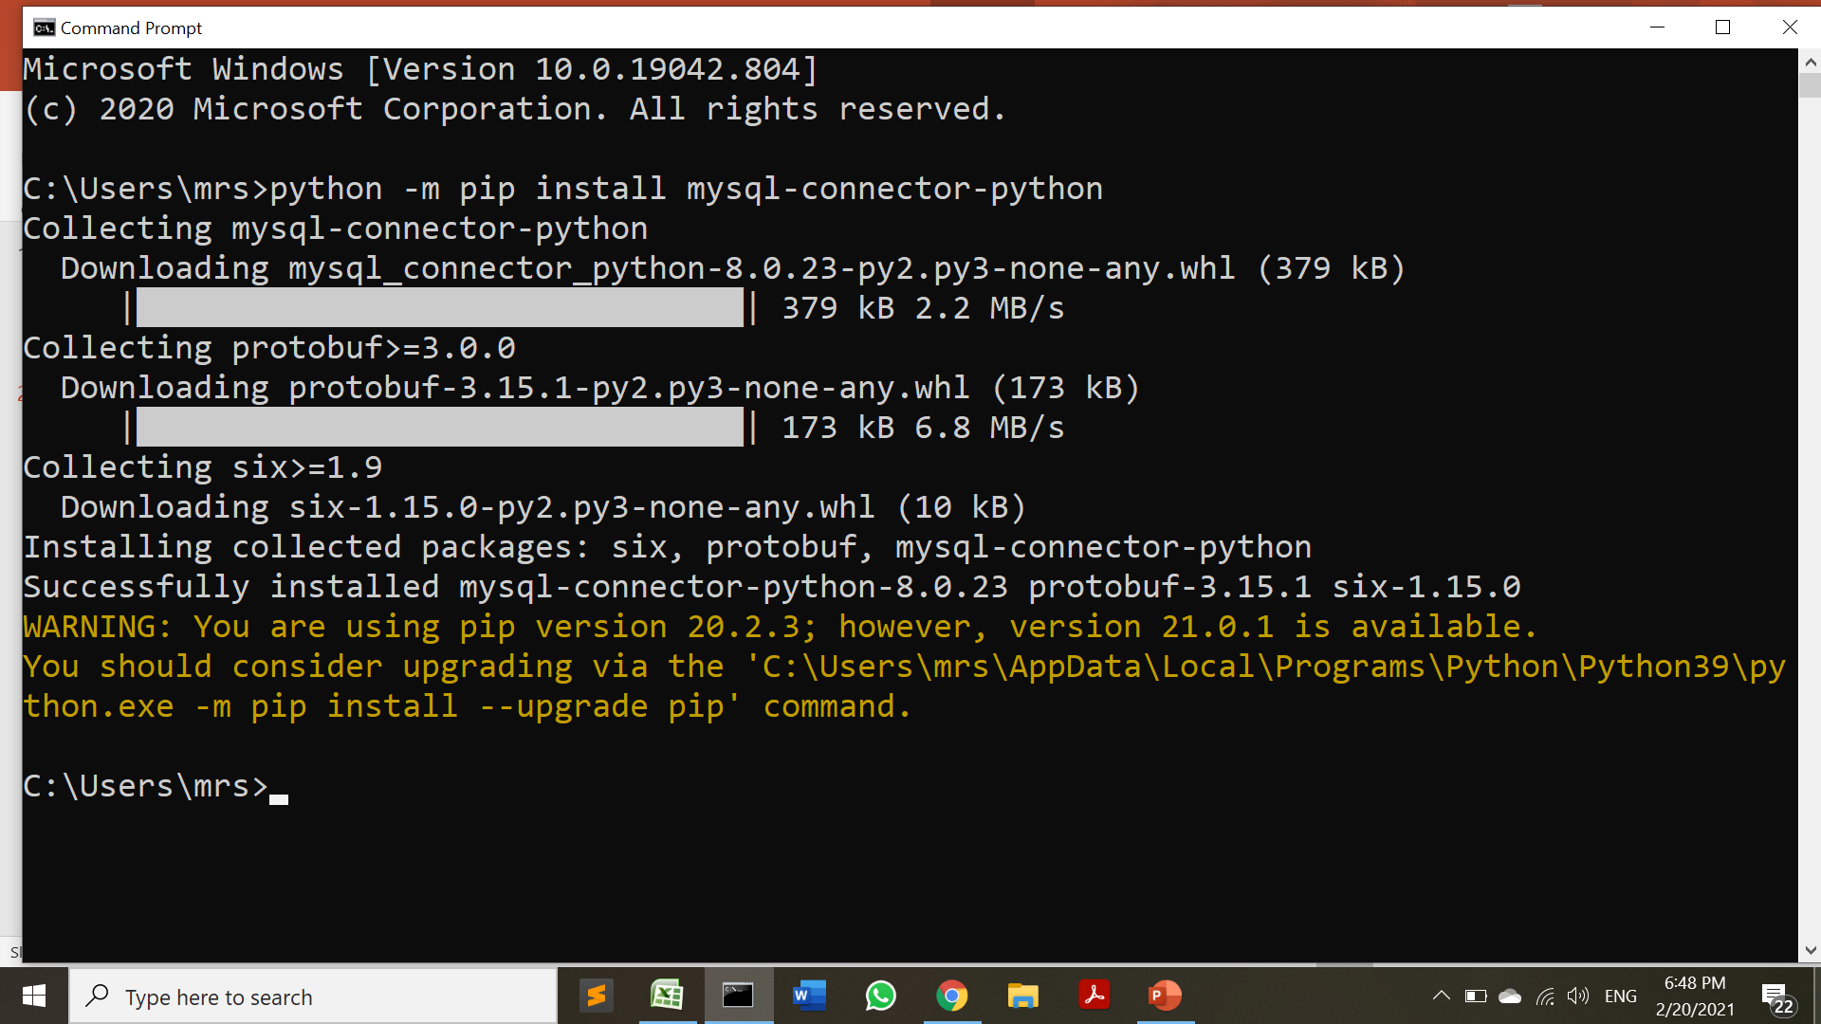
Installing MySQL Diver

Slide 6
Testing MySQL Connection
import mysql.connector
mydb = mysql.connector.connect(
host="localhost",
user="root",
password=""
)
if mydb:
print("Connection Established Successfully")
else:
print("Connection Error")
Connection Established Successfully

Slide 7
Testing MySQL Connection
Steps to connect a python application to the database.
Import mysql.connector module
Create the connection object.
Create the cursor object
Execute the query

Slide 8
Creating a Database
import mysql.connector
try:
con = mysql.connector.connect(
host="localhost",
user="root",
password="",
)
print("Connection Established Successfully")
cur = con.cursor()
cur.execute("create database test2")
print("1")
cur.execute("show databases")
dbs=cur.fetchall()
for x in dbs:
print(x)
except:
print("Connection Error")
1
('college',)
('company',)
('flutter',)
('information_schema',)
('mysql',)
('performance_schema',)
('phpmyadmin',)
('productmaster',)
('test',)
('test1',)
('test2',)

Slide 9
We can specify the database name in the connect() method if we want to connect to a specific database.

Slide 10
Retrieving data from the table
import mysql.connector
try:
con = mysql.connector.connect(
host="localhost",
user="root",
password="",
database="college"
)
print("Connection Established Successfully")

Slide 11
Retrieving data from the table
#creating the cursor object
cur = con.cursor()
print(cur)
#id,name,sem,city
sql="select * from student"
cur.execute(sql)
result = cur.fetchall()
print("ID Name Sem City")
for row in result:
#print(row)
print("%d %s %d %s"%(row[0],row[1],row[2],row[3]))
except:
print("Connection Error")
finally:
if con:
con.close()
print("Resources Released")
Connection Established Successfully
MySQLCursor: (Nothing executed yet)
ID Name Sem City
1 Rakesh 2 Baroda
2 Mahesh 3 Pune
Resources Released

Slide 12
Updating data in the table
import mysql.connector
try:
con = mysql.connector.connect(
host="localhost",
user="root",
password="",
database="college"
)
print("Connection Established Successfully")
#creating the cursor object
cur = con.cursor()
print(cur)
#id,name,sem,city
sql="update student set city='Baroda' where city='Mumbai'"
cur.execute(sql)
print(cur.rowcount,"Records updated")
except:
print("Connection Error")
finally:
if con:
con.close()
print("Resources Released")
Connection Established Successfully
MySQLCursor: (Nothing executed yet)
1 Records updated
Resources Released

Slide 13
Sample Queries
"SELECT * FROM customers WHERE address =‘Parsiwada,Andheri(E)'"
"DELETE FROM customers WHERE address = ’42,Carter Road,Bandra(W)'"
"DROP TABLE customers"
"UPDATE customers SET address = ’23,Beach Heaven,Juhu Koliwada' WHERE address = ’45,Sea Queen,SNDT'"

Slide 14
Tkinter with MySQL

Slide 15
Login Form
from tkinter import *
import mysql.connector
def submitact():
user = Username.get()
passw = password.get()
#print(f"The name entered by you is {user} {passw}")
logintodb(user, passw)
def logintodb(user, passw):
con = mysql.connector.connect(
host="localhost",
user="root",
password="",
database="college"
)

Slide 16
Login Form
cursor = con.cursor()
# A Table in the database
savequery = "select * from login"
try:
cursor.execute(savequery)
myresult = cursor.fetchall()
status=False
# Printing the result of the
# query
for x in myresult:
if x[0]==user and x[1]==passw :
status=True
break;
if status:
print("Login Sccessful")
else:
print("Login Failed")
except:
db.rollback()
print("Error occured")

Slide 17
Login Form
# Creating GUI
root = Tk()
root.geometry("300x300")
root.title("Login Page")
# Definging the first row
lblfrstrow = Label(root, text ="Username -", )
lblfrstrow.place(x = 50, y = 20)
Username = Entry(root, width = 35)
Username.place(x = 150, y = 20, width = 100)
lblsecrow = Label(root, text ="Password -")
lblsecrow.place(x = 50, y = 50)
password = Entry(root, show="*",width = 35)
password.place(x = 150, y = 50, width = 100)
submitbtn = Button(root, text ="Login",
bg ='blue', command = submitact)
submitbtn.place(x = 150, y = 135, width = 55)
root.mainloop()

Slide 18
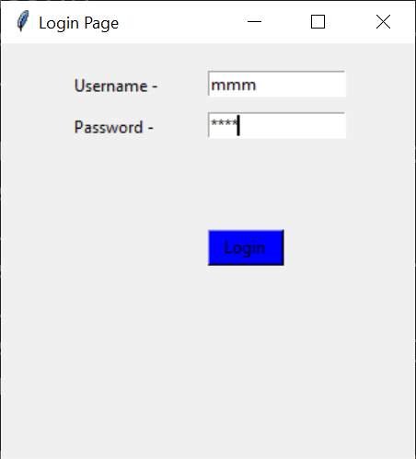
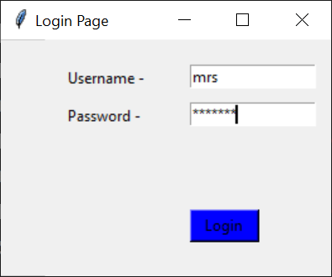
Login Form
Login Failed
Login Sccessful

Slide 19
cur.commit() is required to make the changes in the table.

